Slide 1
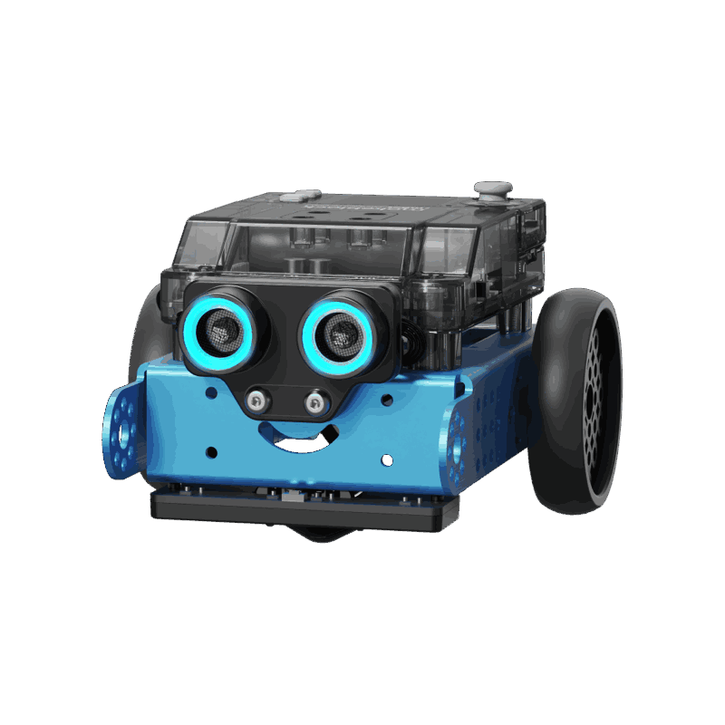
COSC-3070 Programming Autonomous Robot
Autonomous Path Following and Obstacle Avoidance With mBot Neo
Lecturer: Ginel Dorleon
xxxxxx
Huynh Ngoc Tai (s3978680)
Tran Quang Minh (s3988776)
Chau Tung Nguyen ()
"I declare that in submitting all work for this assessment, I have read, understood and agree to the content and expectations of the assessment declaration".

Slide 2
Problem Overview

Slide 3
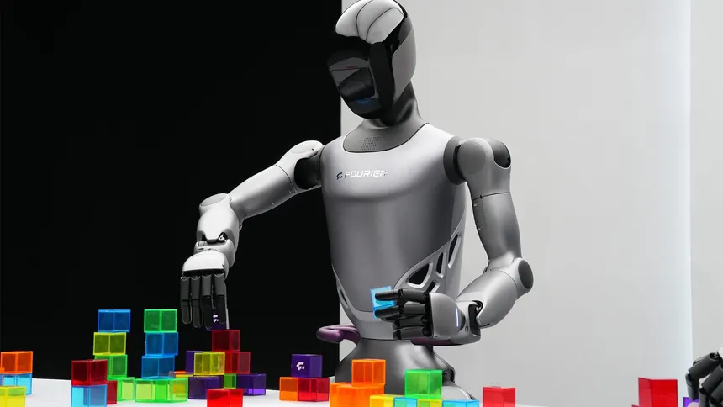
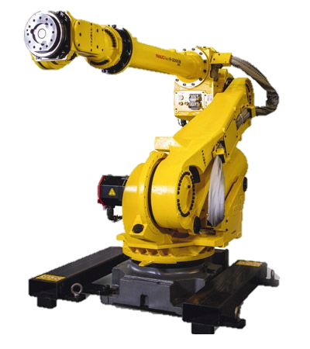
Problem Overview
Autonomous robots are revolutionizing industries like logistics and transportation.
They rely on AI, computer vision, and sensors to interpret paths, detect signs, and avoid obstacles.

Slide 4
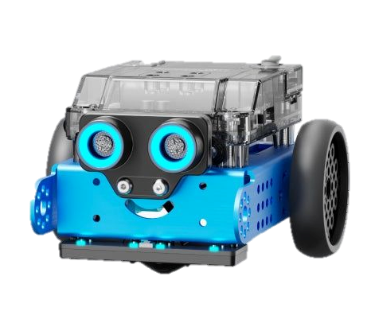
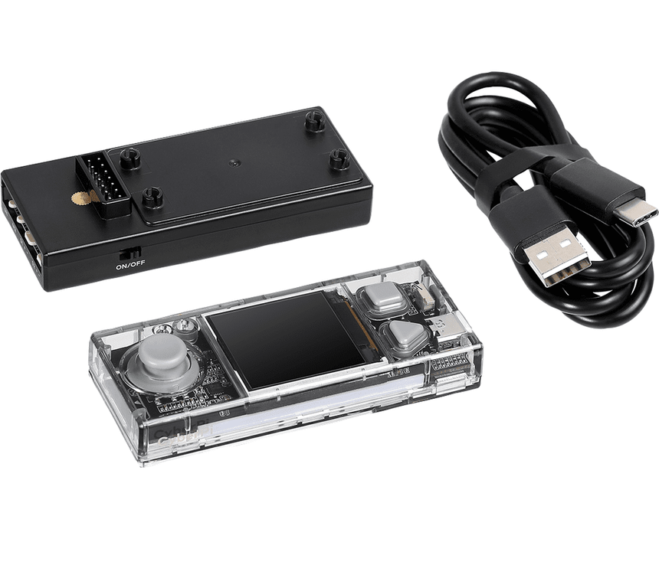
Problem Overview
For the final project of the course, we are given 2 things, which is :
- Cyber Pi is the microcontroller – the brain of the robot.
- mBot2 Neo is the complete robot – includes wheels, motors, sensors.
CODE

Slide 5
Project Setup

Slide 6
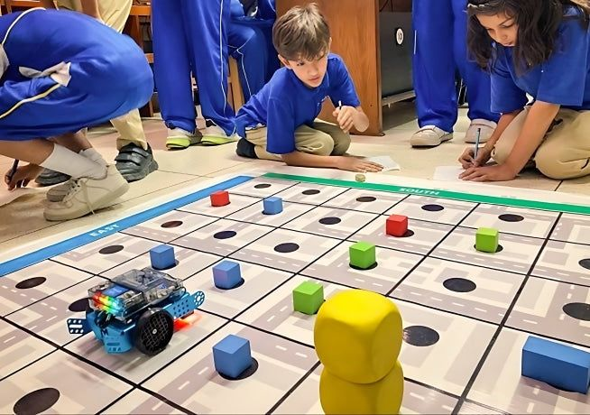
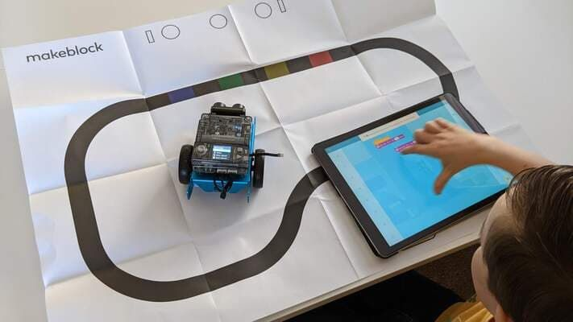
Problem Overview
The aim of the project is to simulate read-world autonomous robot using simple sensors and vision systems, which then the robot will need to successfully navigate a maze-like environment following and act accordingly to the signs it will sensor, or the obstacles along the way like an AI powered robot in the real world.

Slide 7
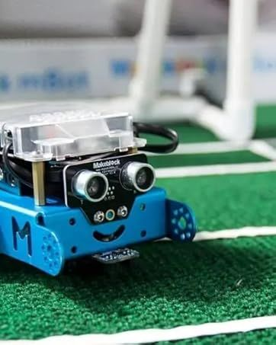
Problem Goal
For the demo, the robot must navigate a complex maze using only onboard logic, no remote control or intervention.
It follows traffic rules: stop on red, go on green, slow on yellow, and even handle combinations like yellow-to-green transitions. It must also avoid static obstacles automatically and reroute in T-junctions when needed.

Slide 8
Methodology

Slide 9
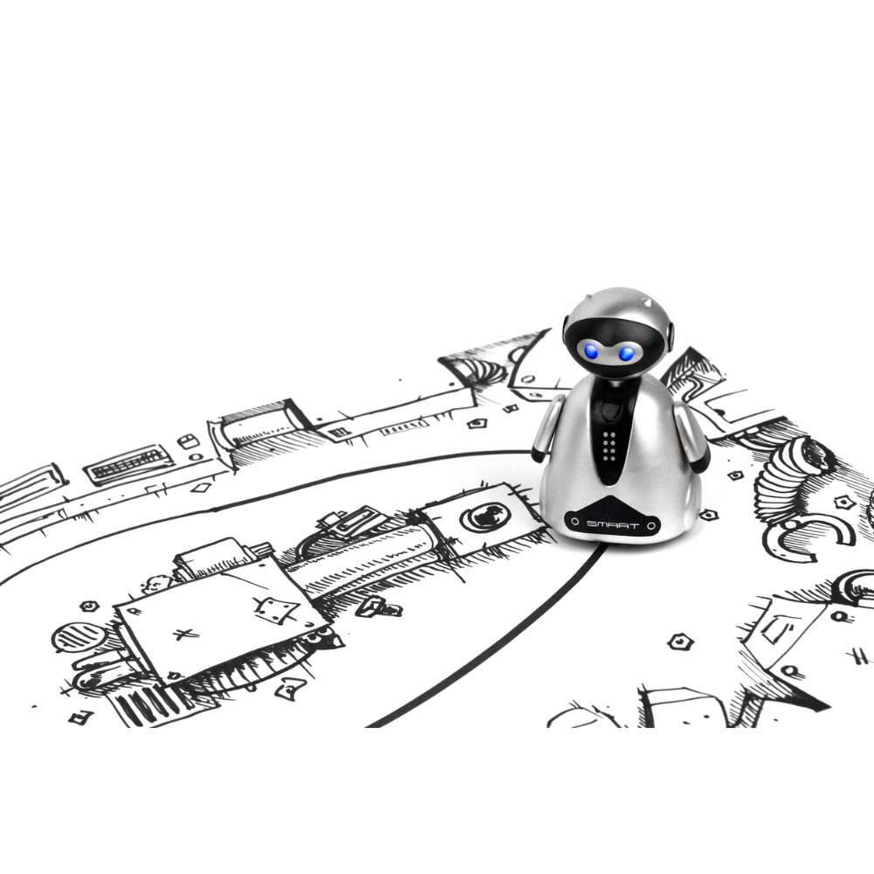

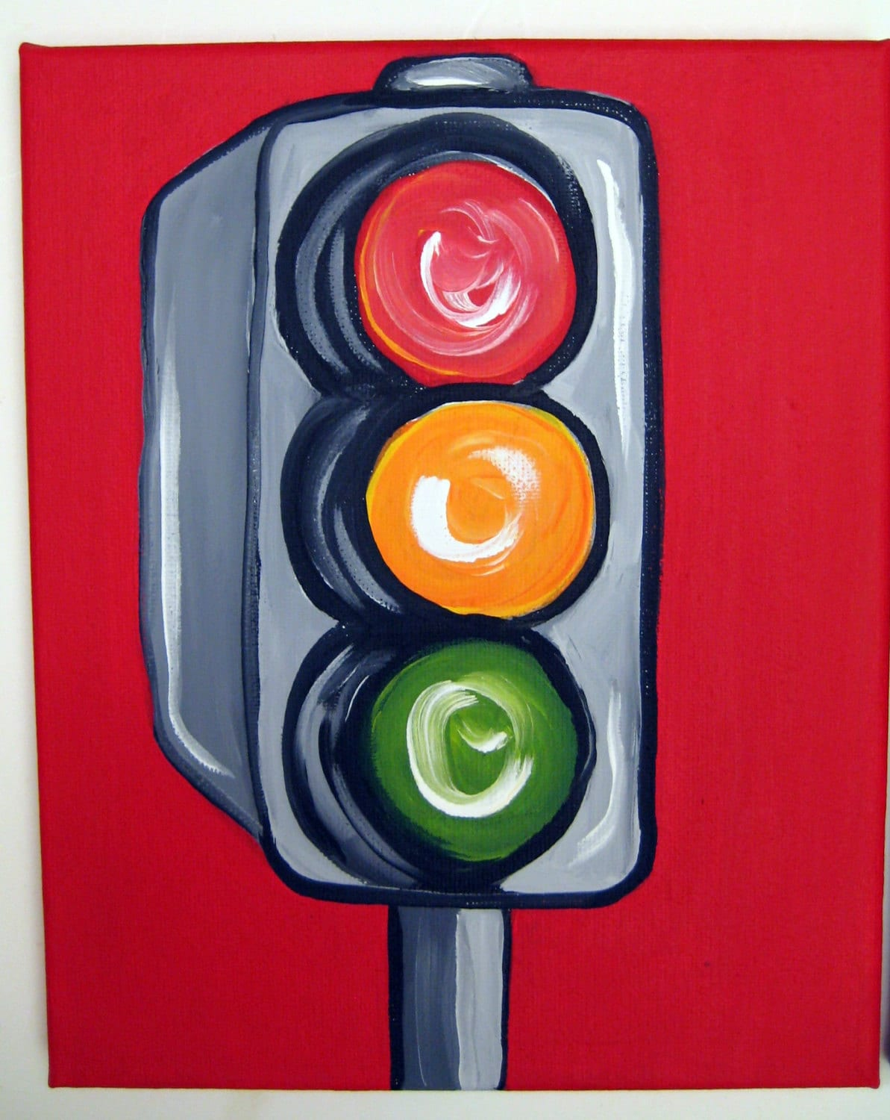
Methodology
Our method integrates three modules—path tracking, visual detection, and obstacle avoidance—into a unified loop.
Line tracking using RGB sensor
Obstacle detection with ultrasonic sensors
Visual sign detection with RGB sensor

Slide 10
Obstacle detection with ultrasonic sensors
Continue Running
Check if there’s anything in front of the car
Yes
Stop Running
No
Yes
Wait for 10s to see if obstacle is cleared
No
Turn 180 degree and run

Slide 11
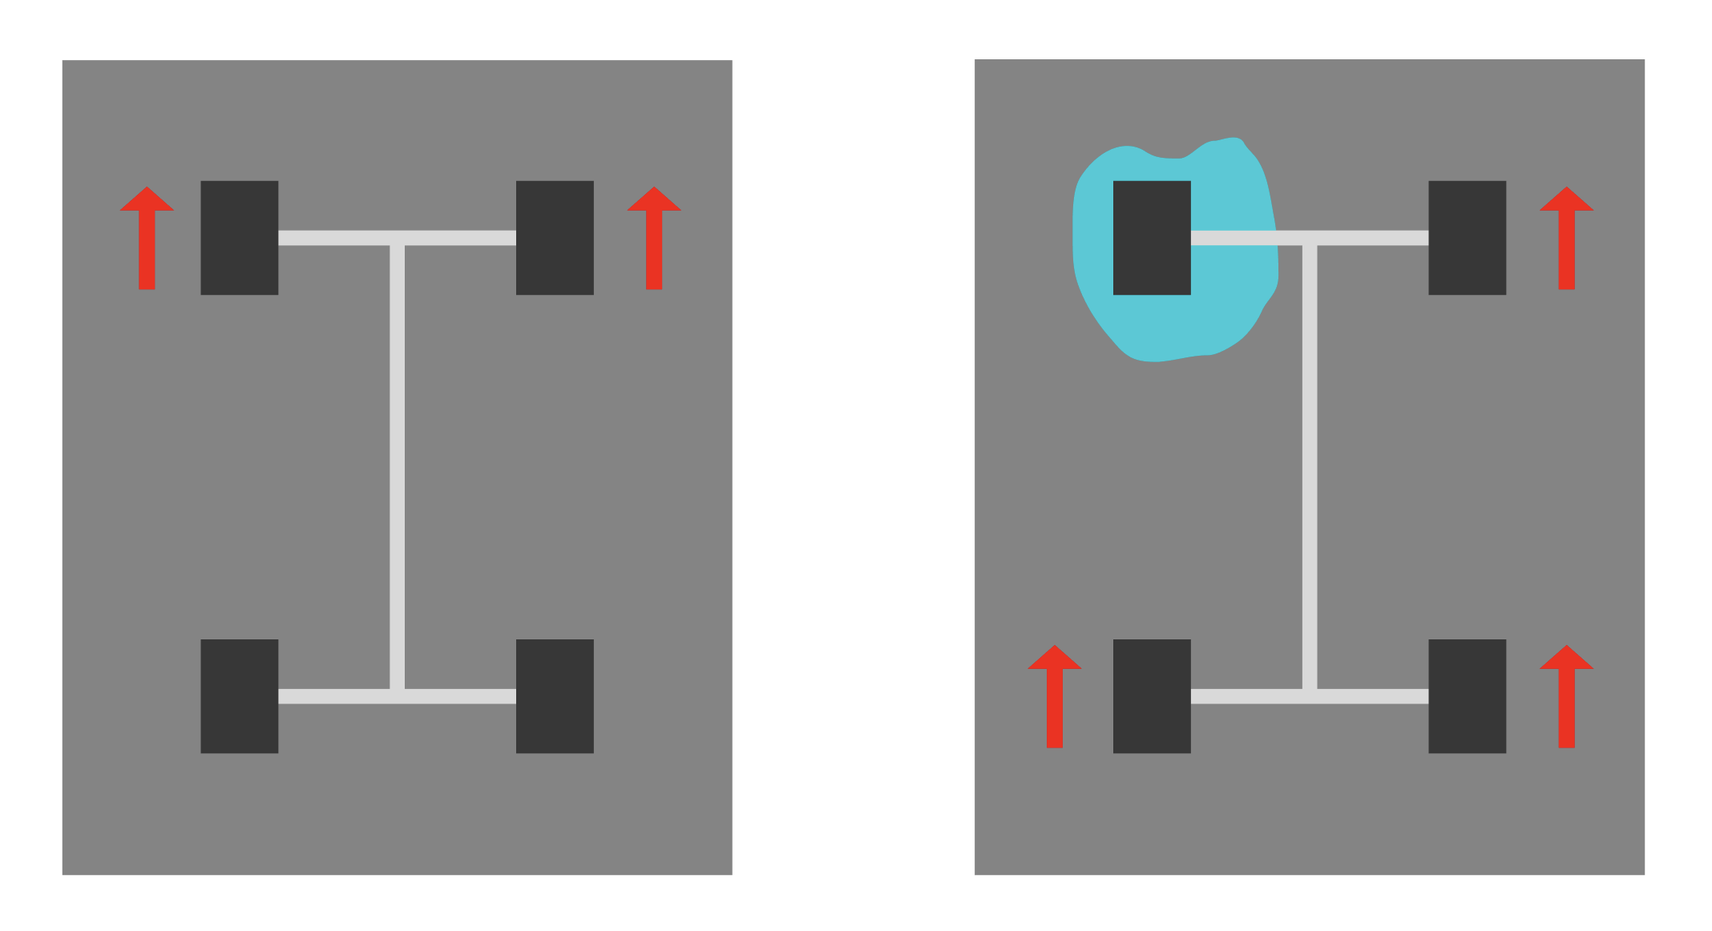
Line tracking using RGB sensor
base_power: the forward speed baseline
kp: proportional gain to control steering strength
offset: deviation from center line (negative = left, positive = right)
Motor speed formulas:
right_power = base_power - kp × offset
left_power = -1 × (base_power + kp × offset)

Slide 12

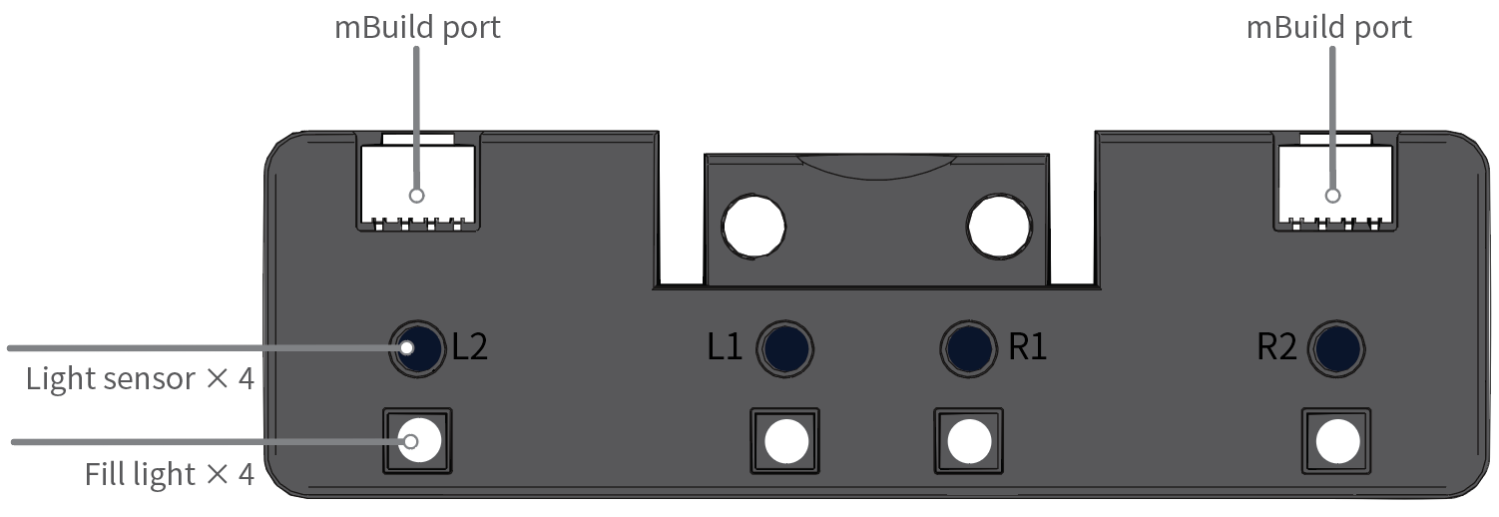
Visual sign detection with RGB sensor
Stop the car, will wait for 10 seconds then turn back
Slow the car
Will tell the car to run after being stopped by red light
Will check the colour of the sign under it to perform action accordingly

Slide 13
Implementation

Slide 14



Implementation

Slide 15
Testing

Slide 16
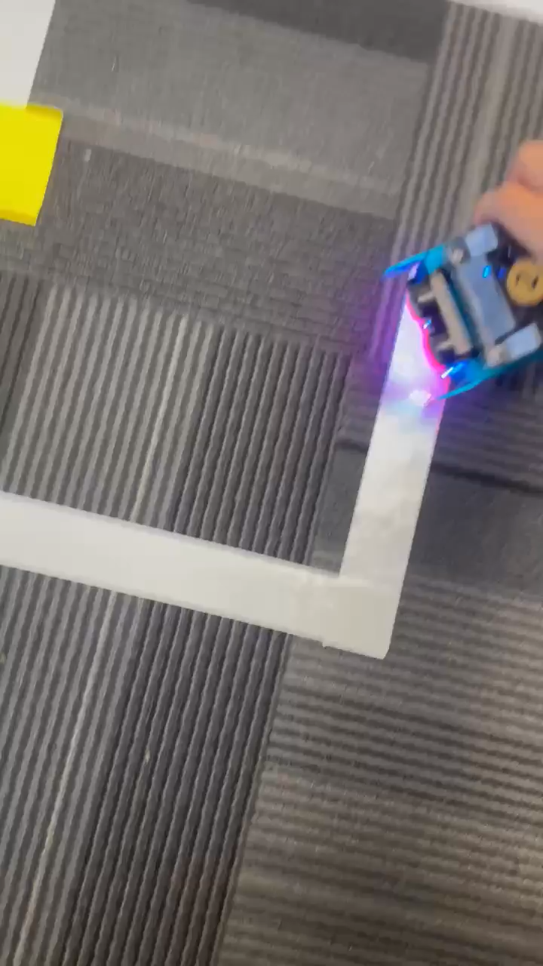
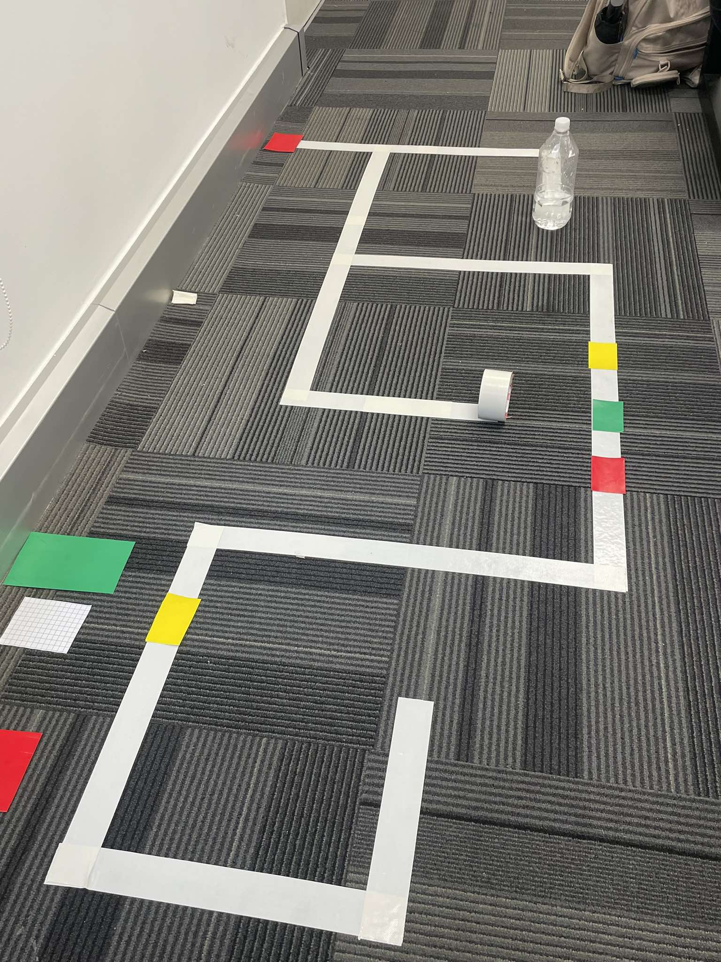
Testing
As per the requirement from the assignment, we decided to create a maze which satisfy most of the objectives the robot need to be able to do:
Avoid obstacle
Perform sign actions
Navigate when it meets T turn
….

Slide 17
Result, Evaluation and Conclusion

Slide 18
Result, Evaluation and Conclusion
Successfully completed tasks with decent-performing models.
The robot responded correctly to all sign-based instructions
Obstacle avoidance worked reliably under varied layouts.
Minor challenges like lighting and alignment drift were resolved through recalibration and logic tuning.

Slide 19
COSC-3070 Programming Autonomous Robot
Autonomous Path Following and Obstacle Avoidance With mBot Neo
THANK YOU FOR LISTENING TO OUR PRESENTATION AND WISH YOU A NICE DAY
"I declare that in submitting all work for this assessment, I have read, understood and agree to the content and expectations of the assessment declaration".

